Slide 1

Critical system
Prabesh Adhikari
MBA IT 8th Batch
School of Management,
Tribhuvan University

Slide 2

Agenda
Introduction
Types
Key Features and Challenges
Life Cycle
Future Trends

Slide 3

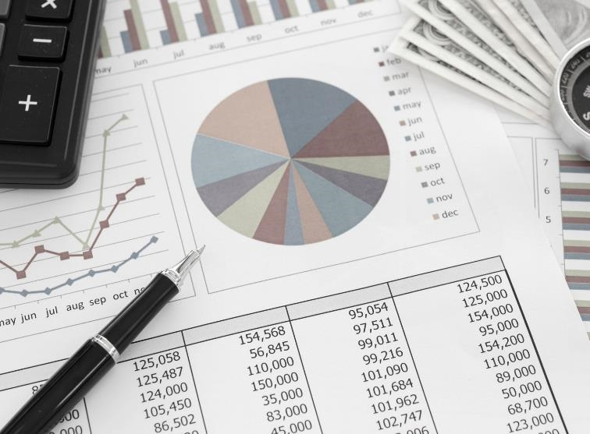
Introduction
Critical systems are systems whose failure or malfunction can have severe consequences, including loss of life, environmental damage, financial losses, or compromised national security.
Diverse Application
Safety and Reliability
Redundancy and Fault Tolerance
Regulations and Standards

Slide 4

Types
Embedded Systems e.g. ABS
Safety Critical Systems e.g Nuclear Power Plant Control System
Mission Critical system e.g UAV Systems (Drome)

Slide 5
Key Features and Challenges
Key Features
Challenges
High Reliability and Availability
Safety and Security Concerns
Redundancy and Fault Tolerance
Complexity
Regularity Compliance
Cost and Time Constraints

Slide 6
Life Cycle of Critical Systems
Key Points
Ensuring Safety
Security
Requirements Analysis
Design and Architecture
Implementation
Testing and Validation
Maintenance and Monitoring
Safety Standards
Risk Assessment and Mitigation
Failure Modes and Effects Analysis
Cybersecurity Threats
Security Standards
Secure Development Practices

Slide 7
Case Studies
Space Shuttle Program
Air Traffic Control System
ICU (Healthcare)
Initiative by Nasa from 1981 to 2011
Role in transporting astronauts and cargo to and from space
Disaster on 1986
Responsible of safe and efficient movement of aircrafts
Mission critical for ensuring orderly departure and landing
Air Canda Southwest nearly collision in SF, USA
Medication Delivery Systems
Supports critically ill patients including ventilators
COVID-19 strain

Slide 8
Future Trends
Artificial Intelligence and Machine Leaning
IoT integration
Automation and Autonomy

Slide 9



Summary
Pivotal components of Modern Society
Widely vary with application, requirements and consequence
Various types
Will be shaped by advancements in technology, changing industry demands and increasing complexity of modern infrastructure

Slide 10


THANK YOU

